Slide 1
Rental scams campaign
Social media pack
#MeetTheLandlord

Slide 2
Rental Scams Social Media Campaign
The Chartered Trading Standards Institute Consumer Empowerment Alliance and Consumer Friend have launched a new campaign warning consumers of the dangers of rental scams. Action Fraud reports the average rental scam victim in the UK loses £1,400.
We are hoping you will support the campaign with the below information and draft social media posts over the course of July and August.
Hashtags to use:
#ScamAware #RentalScams #NoMoneyUpfront #MeetTheLandlord

Slide 3
Rental Scams Social Media Campaign
Key information:
Rental scams typically involve a criminal posing as a landlord or property manager to make potential renters pay money for a property that isn’t available, doesn’t exist, or isn’t theirs to rent out. These scams can occur in various ways.
Phantom Rentals: Listings for properties that don’t exist or aren’t for rent. Criminals pull you in with attractive photos and great deals.
Hijacked Ads: Criminals copy legitimate rental ads and change the contact details, directing inquiries to themselves instead of the rightful owner.
Bait-and-Switch: The property advertised is unavailable, but the criminal offers a different, often inferior, property.

Slide 4
Rental Scams Social Media Campaign
To avoid rental scams, watch out for these common warning signs:
Low rent: If the rent is significantly lower than other properties in the area, be cautious.
Upfront Payments: Be wary of landlords who ask for money upfront before seeing the property, especially if they request payment via a bank transfer, cryptocurrency, or gift cards.
No In-Person Meetings: Criminals often avoid face-to-face meetings. If the "landlord" is unable or unwilling to meet you in person or show you the property, this is a warning sign.

Slide 5
Rental Scams Social Media Campaign
To avoid rental scams, watch out for these common warning signs:
High-Pressure Tactics: Criminals may pressure you to act quickly, claiming there are other interested people or that the offer is available for a limited time only.
Incomplete or Vague Information: Legitimate listings provide detailed information. Be suspicious of ads with limited photos, vague descriptions, or typos and errors. If it’s an agent, they must belong to a redress scheme.

Slide 6


Suggested text:
🛑 Don’t get scammed! Rental scams are on the rise.
Watch out for red flags like too- high-pressure tactics.
Always meet the landlord or agent in person and verify the property details.
Stay smart and rent safely!
#RentalScams #MeetTheLandlord
Right click and save picture

Slide 7

Suggested text:
🔍 Searching for a new home? Watch out for rental scams!
Be cautious of unusually low rents, urgent requests for payment, and landlords who won’t meet in person.
Do your homework!
#RentalScams #ApartmentHunting #StaySafe
Right click and save picture

Slide 8

Suggested text:
🚨 Beware of rental scams.
Avoid upfront payments, insist on meeting the landlord in person, and always verify property details.
Stay safe out there!
#ScamAware #RentalScams #MeetTheLandlord
Right click and save picture

Slide 9

Suggested text:
🚨 Beware of rental scams! 🚨
Avoid upfront payments, insist on meeting the landlord in person, and always verify property details. Stay safe out there!
#ScamAware #RentalScams #NoMoneyUpfront #MeetTheLandlord
Right click and save picture

Slide 10
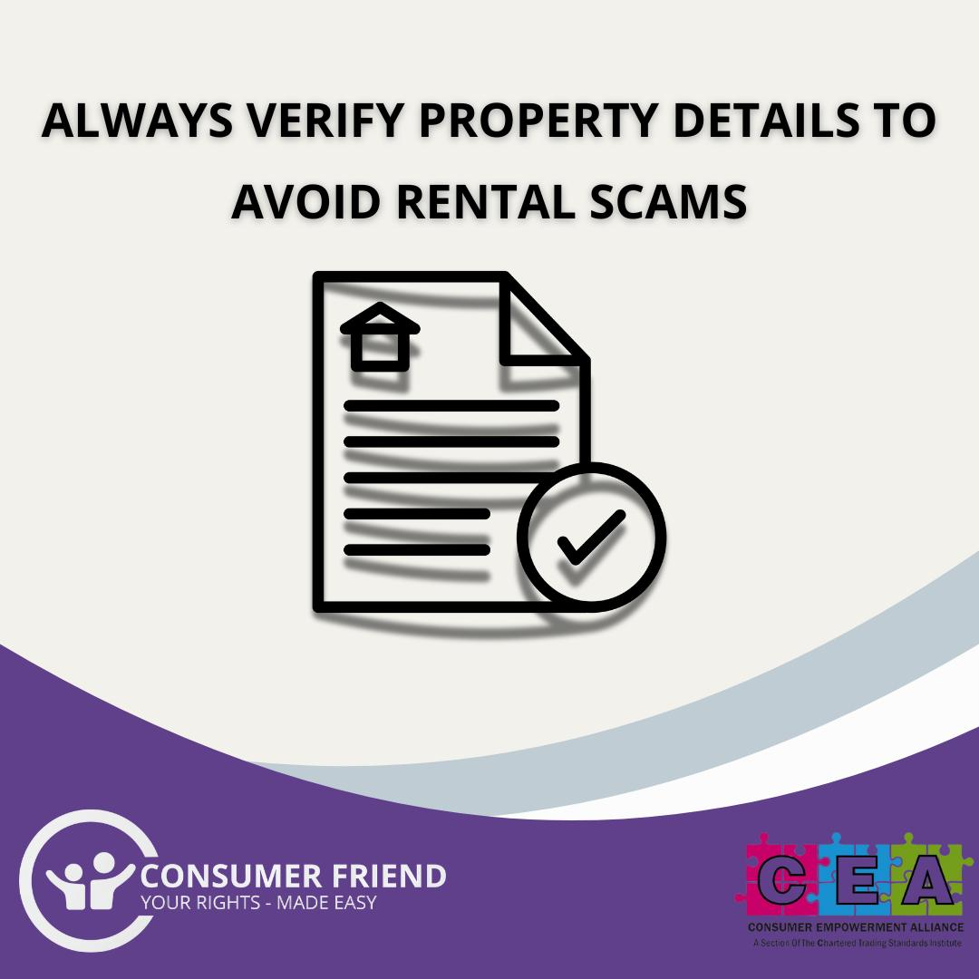
Suggested text:
Navigating the rental market? Be aware of rental scams!
Criminals often use high end photos of properties that don’t exist, high-pressure tactics, and avoid in-person meetings.
Ensure you research the property, verify ownership, and use secure payment methods.
Stay informed and protect yourself.
#ScamAware #RentalScams #NoMoneyUpfront #MeetTheLandlord
Right click and save picture

Slide 11

Suggested text:
Are you house or flat hunting? 🏡
Look out for rental scams! Look out for pristine pictures and high-pressure tactics, and requests for unusual, potentially unprotected ways to transfer money.
Always visit the property in person and verify the landlord's details.
#ScamAware #RentalScams #NoMoneyUpfront #MeetTheLandlord
Right click and save picture

Slide 12
Suggested text:
📢 Renting a new place? Avoid rental scams! 🚫🔍
Research the property and landlord
Avoid upfront payments
Always visit the property
Verify ownership
Use reputable rental platforms.
Stay safe!
#RentalScams #NoMoneyUpfront #MeetTheLandlord
Right click and save picture

Slide 13
Suggested text:
🕵️‍♂️ Don’t get caught in a rental scam!
Always visit the property in person, verify ownership, and use reputable platforms. High-pressure tactics and vague listings are red flags.
Protect yourself!
#ScamAware #RentalScams #NoMoneyUpfront #MeetTheLandlord
Right click and save picture

Slide 14
Suggested text:
Hunting for a new home?
Use reputable rental platforms.
Check landlord out and verify ownership.
Don’t pay before you see the property and when you do, pay rent securely
Make sure you find out which deposit protection company they use – you should get confirmation that your money is protected.
#ScamAware #RentalScams #NoMoneyUpfront #MeetTheLandlord
Right click and save picture

Slide 15
For more information or to talk to us about this or any other campaign please contact us.
info@consumerfriend.org.uk

